Slide 1

Song recommendation System
Presented by:
Nishant Devlal S24CSEU1749
Rohit Saini S24CSEU1775
Khyati S24CSEU1781

Slide 2

PROBLEM statement
In the age of digital music streaming, users are overwhelmed by the vast number of songs available. Traditional recommendation systems often rely on user behavior (likes, ratings, or listening history), which struggle with cold-start problems (new users or new songs) and often lack personalization based on lyrical themes.
How can we recommend songs that are lyrically similar to a user’s favorite track, even when user interaction data is limited or unavailable.
A song recommendation system is a subclass of an information filtering system that personalizes song suggestions to a user.
Major streaming services like Spotify and YouTube Music rely heavily on these systems, which typically employ machine learning techniques such as:
Collaborative Filtering
Content-Based Filtering.

Slide 3
Proposed Solution: Content-Based Filtering
Content-based filtering is a recommendation technique that suggests items (like songs, movies, etc.) that are similar to items that a user liked in the past.
When generating recommendations, the system compares the features of all available unrated items against the user's preferences.
It uses metrics like cosine similarity to mathematically determine how closely a new item's features match the user's established preferences.
The items with the highest similarity score to the user's profile are the ones recommended.

Slide 4

Goals And objective
To build a robust and scalable song recommendation system that suggests songs based on lyrical similarity, enhancing user experience through meaningful and personalized music discovery.
Handle cold start scenarios by relying on content- based filtering rather than user history.
Optimize performance by serializing precomputed similarity matrices and cleaned data using pickle.
Design a user-friendly interface.
Ensure modularity and scalability for future integration with audio features and collaborative filtering.

Slide 5
Dataset Description And Technologies Used
Dataset: Bollywood_Songs (2017-2023) This dataset contains information about Bollywood songs including song names, singers, album names, release years, lyrics and thumbnails collected from various sources.
Technologies Used: Python, Jupyter notebook, Streamlit, Spotipy, Pandas, Pickle, TfidfVectorizer, cosine_similarity

Slide 6
Project Features
Intelligent Song Recommendation
Dynamic UI and Theme Toggle
Spotify integration
Visual Recommendation Cards
Fast and Lightweight Backend

Slide 7

Implementation
Data Preprocessing:
1. Using only the columns of dataset that are required (music_name, singer, lyrics).
2. Checking for null values present in the dataset and handling them (dropna).
3. Stemming to help reduce vocabulary size and normalize similar words.
Example: ‘Playing’ -> ‘play’
4. Tokenization to prepare text for vectorization.

Slide 8
Implementation
Similarity Computation:
1. Vectorization of Lyrics: Used TfidVectorizer to convert lyrics into numerical vectors.
2. Similarity Matrix: Applied cosine_similarity to compare each song vector with other.
3. Recommendation Function: For a selected song, retrieved its index in the dataset.
Sorted similarity scores to find top 5 most similar songs and returned them.
4. Integration with Spotify API: Fetches album cover and a link for the recommended songs.
User selects a song
TF-IDF Vector
Cosine Similarity
Top 5 Matches
Display with Spotify Data

Slide 9
Implementation
User Interface
1. Framework Used: Streamlit – a fast and intuitive way to build interactive web apps in Python.
2. Design Philosophy: Minimalistic and responsive UI focused on use experience and simplicity.
3. Interactive song selection: Dropdown menu for choosing song from the dataset.
4. Theme Toggle: Light and Dark mode enhances user comfort.

Slide 10
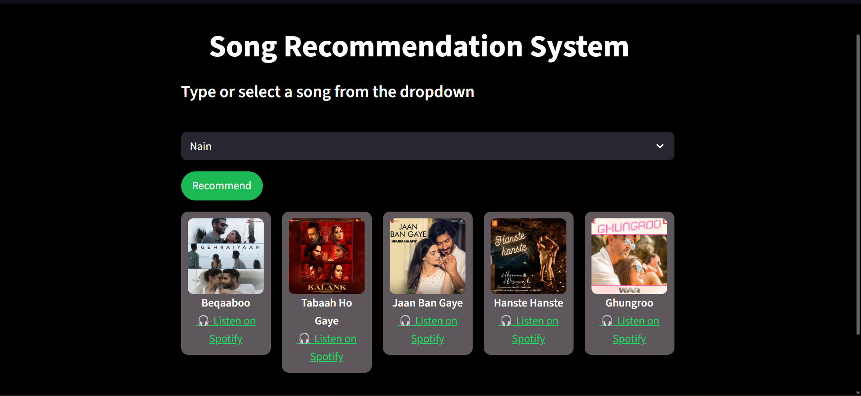
Screenshots (dark theme)

Slide 11
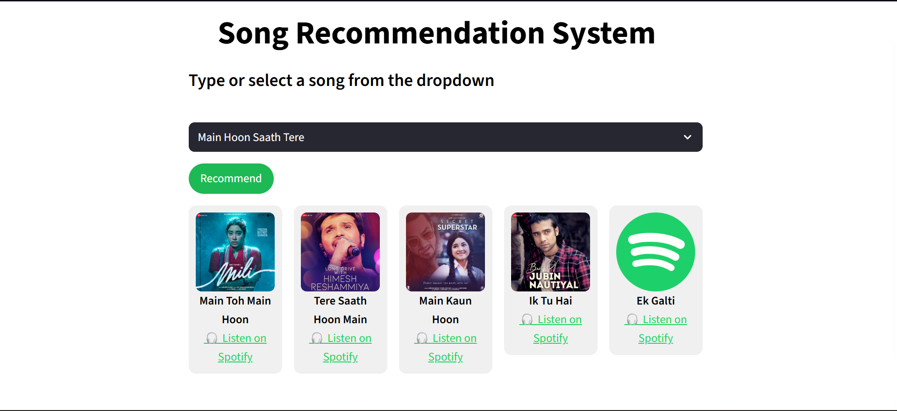
Screenshots (LIGHT theme)

Slide 12

Conclusion
Recap of the Goal:
We set out to build a system that helps users discover music they love, effortlessly and intelligently.
Summary of the Approach:
By combining lyrics and user preferences, we created a personalized recommendation system with a user-friendly UI.
Impact:
This system enhances user engagement, reduces decision fatigue, and opens doors to musical exploration.
Future Prospects:
Future enhancements could include mood detection,
genre filtering, and hybrid models combining lyrics with
audio features.

Slide 13
Thank You

